Slide 1

APEX China Clinical Decision Making in mHSPC: Patient-specific factor for treatment selection
Dr. Matthew Chiu

Slide 2
Current Evidence in mHSPC Treatment: Systemic Therapies and Local Interventions
Christopher Sweeney

Slide 3
Disclosures

Slide 4

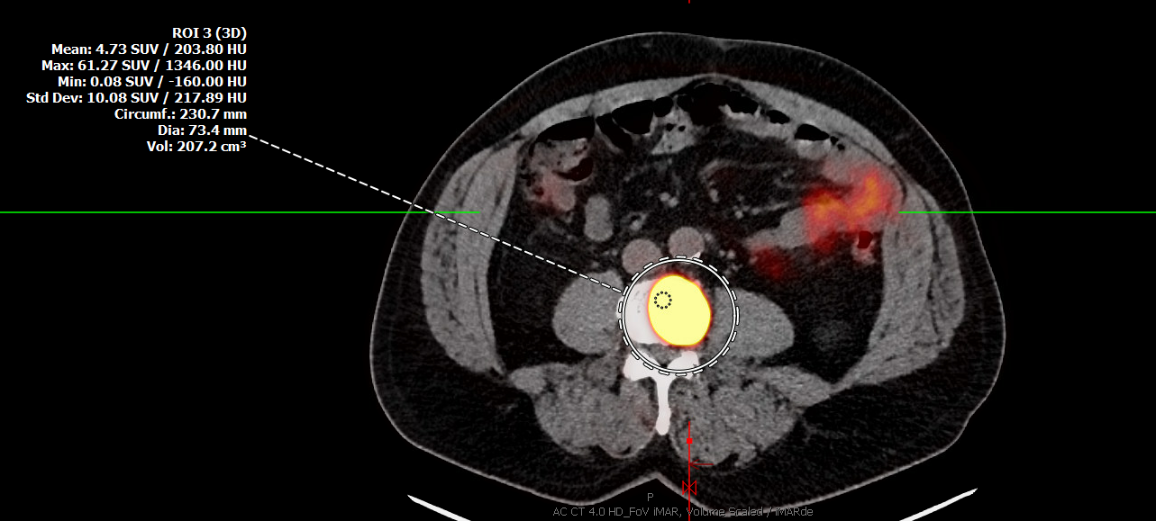
Diagnosis of mHSPC
ECOG performance status: 0
PSA: 15 ng/mL
Prostate biopsy: Adenocarcinoma, Gleason score 5+4=9 in 10/10 biopsy cores
Genetics: No mutation detected
Imaging: Four bone metastases
Treatment goals: Maintain daily living for as long as possible
Male, age 61
Medical history:
Diabetes, hypertension, GERD
Disclaimer: This presentation discusses a hypothetical case. My treatment recommendations for this case reflect my experience or my personal opinion.
Patient image was generated using artificial intelligence

Slide 5
Poll Question
Which type of imaging would impact your treatment decision for this patient?
A
PSMA-PET/CT
B
Conventional imaging
补充二维码
C
Both
Please scan the QR code

Slide 6
关于APEX PPT中的字体字号，新的英文版PPT在后续修改的时候，请修改：
全篇英文字体均为Avenir Next LT Pro
-封面（P1）：40号字
-每一页的标题：根据内容灵活调整（28-36号）
-参考文献和缩略语：9号浅灰色（文字太多可改为8号，见下一页参考文献部分）
如果是中文PPT，选择常规的字体即可。

Slide 7
The Prevalence of Underdosing in Real-World Practice Varies Between ARIs, Potentially Impacting Effectiveness
题目参考颜色
ARASHI is a retrospective observational cohort study of over 2,700 patients with nmCRPC using administrative health claims data in Japan, evaluating the approved ARIs
Patients receiving darolutamide were more likely to initiate treatment at the label dose (78%) vs enzalutamide (58%) and apalutamide (62%)
Among those who received an ARI at the label dose at treatment initiation, patients receiving darolutamide:
  Continued treatment for longer than those receiving enzalutamide or apalutamide
  Progression to mCRPC was slower
柱状图参考颜色
正文参考颜色
文献和脚注
参考颜色
6-months
12-months
18-months
24-months

